Slide 1

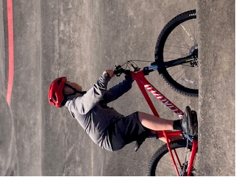
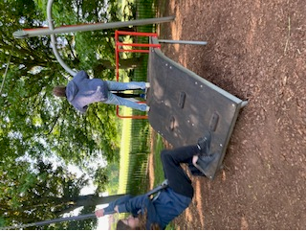
Social and physical literacy
Providing the framework for success in Physical education, games and sport at pathways learning centre

Slide 2
OUTLINE
Background
Rationale for change
Suggested methodology
Next Steps

Slide 3
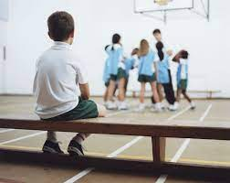
Background
“I hate PE”
“I never did it”
“I used to hide in the toilets”
“I didn’t like the shouting”
“I would always be ill or make an excuse when we had PE”
“I don’t enjoy playing football”

Slide 4
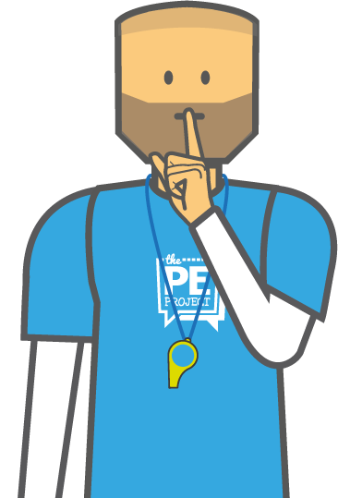
Background
Students at PLC often arrive with a very negative prior-experience of PE. They explain in their welcome sessions and questionnaires that traditional approaches (although much improved) to PE left them feeling isolated, overwhelmed & inhibited; so much so that a significant proportion of our students did not take part at all.
With that in mind, the subject name was changed to ‘games’ to make it less threatening and barriers to entry like kit, changing, teaching style & subject content were adapted to best meet the needs of our students. Over time, with the depth of subject knowledge and relationship-based approach of our brilliant ‘PE’! Team we have formulated a methodology for success based on developing social and physical literacy hand-in-hand. It now seems appropriate to formalise this day-to-day practice and reflect it in our planning and assessment for student progress.

Slide 5
Rationale for change
Social and physical literacy is at the heart of all we do.
Physical literacy has been described as:
“the combination of our enjoyment, confidence, competence, understanding and knowledge of how to be active” or put more simply,
“the joy of learning how to move”
Social literacy has been described as “the development of social skills to interact positively in a defined environment.”
Our students often arrive here with significant gaps in both physical and social literacy and providing a framework for success depends upon developing both areas in tandem so that they are able to leave here with the skills, know-how and confidence to lead healthy and satisfying lives.

Slide 6
As educators we obviously strive for the development of pupil motivation and self esteem in the context of physical activity. As we know, the development of physical literacy depends as much, if not more, on the nature of the interaction between the teacher and the pupil, as on the content of the lesson. Above all physical education must provide a positive and rewarding experience for all young people – whatever their ability. At the heart of Physical Literacy is the motivation to take part in physical activity. This is acquired as young people make progress in movement mastery and develop self confidence and self esteem in this significant aspect of their human potential.

Slide 7
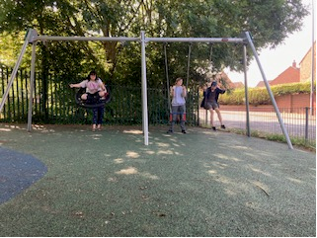
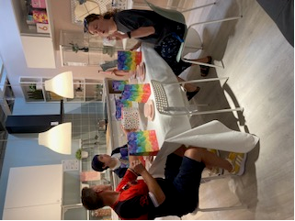
Suggested METHODOLOGY
5 OVER-ARCHING THEMES FOR Social Literacy within PE
I can work collaboratively with my peers to achieve common goals during physical activities.
I can communicate effectively with others during physical activities
I can show respect for the diversity of cultures, abilities, and backgrounds during physical activities.
I can demonstrate empathy towards others during physical activities.
I can show responsibility for my actions during physical activities.

Slide 8




I can statements for social literacy
I CAN……..
Take turns
Play fairly
Work effectively in a pair
Work effectively in a small group
Play a set role in a team
Take advice
Help others
Collaborate by being an effective role model
Talk about what I want to do
Listen to others
Take cognisance of others view points
Engage in active listening
Negotiate with other students to establish rules
Negotiate with other students to resolve conflicts
Ask questions &
Respond to questions
Work effectively with different members of the community
Challenge instances of lack of understanding of respect for the diversity of cultures, abilities and backgrounds during physical activities
Be polite and respectful in our local community
Recognise someone needs help
Help another student
Recognise that someone is hurt
Offer to find help
See others’ points of view
Engage in activities that challenge my own view point
Work safely on my own
Work safely in pairs
Work safely in a small group
Recognise how my actions have impacts upon others
Understand when I have found something difficult
Help provide solutions for overcoming difficulties

Slide 9
5 over-arching themes for Physical Literacy within PE
I can demonstrate competency in fundamental movement skills, such as running, jumping, throwing, catching, and kicking, with accuracy and control.
I can apply and adapt my movement skills in a variety of physical activities, games and sports, showing an understanding of basic tactics, strategies, and rules.
I can assess and monitor my own physical fitness levels, setting personal goals and demonstrating improvement in areas such as strength, flexibility, endurance, and cardiovascular health.
I can participate in individual, cooperative and competitive physical activities, demonstrating good sportsmanship, teamwork, and respect for others.
I can make informed decisions about my own health and well-being, applying knowledge of working safely, of proper nutrition, injury prevention, and the benefits of an active lifestyle.

Slide 10

I can statements for PHYSICAL literacy
I CAN……..
Exhibit agility by quickly changing directions, accelerating, and decelerating in response to stimuli
Demonstrate flexibility by performing stretches and movements that involve a wide range of motion in different joints.
Exhibit strength and muscular endurance through activities that require pushing, pulling, lifting, and holding positions.
Demonstrate cardiovascular endurance by sustaining physical activity over an extended period without excessive fatigue.
Demonstrate control and coordination of body movements in activities that involve rhythm, dance, or gymnastics.
Show proprioception and kinesthetic awareness by accurately perceiving and controlling body movements and positions.
Exhibit reaction time by quickly responding to visual or auditory stimuli during drills or games.
Demonstrate dexterity and hand-eye coordination in activities that involve manipulating small objects or performing fine motor skills.
Exhibit bilateral coordination by performing movements that require both sides of the body to work together.
Demonstrate gross motor skills by engaging in activities that involve large muscle groups, such as running, jumping, or climbing.
Exhibit neuromuscular control and stability during activities that involve balance and weight shifting.
Show adaptability and improvisation by modifying movements and strategies in response to changing game conditions or constraints.
Demonstrate proficiency in basic locomotor skills such as running, jumping, hopping, and skipping.
Perform a variety of manipulative skills, including throwing, catching, kicking, and striking with accuracy and control.
Exhibit balance and coordination while engaging in static and dynamic movements.
Demonstrate proper form and technique in executing fundamental movement patterns, such as squatting, lunging, and jumping.
Exhibit speed by moving quickly and efficiently in various activities and sports.
Show accuracy and precision in targeting objects or specific areas during throwing, kicking, or striking activities.
Demonstrate spatial awareness by navigating through obstacles, judging distances, and coordinating movements in confined spaces.
Exhibit proper body alignment and posture during static and dynamic movements.

Slide 11
I can statements for PHYSICAL literacy
I CAN……..
Assess my own physical fitness level through various tests and measurements.
Make informed decisions about the appropriate intensity, duration, and frequency of physical activity
Demonstrate an understanding of the importance of proper warm-up and cool-down routines to prevent injuries.
Identify and evaluate the impact of external factors, such as environmental conditions & equipment safety
Critically analyse and make decisions about the use of technology and media in promoting physical activity and well-being.
Analyse and evaluate the potential risks and benefits of different physical activities
Demonstrate an understanding of proper body mechanics and techniques to prevent injuries during physical activities
Assess and manage my stress levels effectively by incorporating stress-reducing strategies
Make informed decisions about my nutritional choices
Identify potential hazards and implement safety measures to minimize the risk of accidents or injuries during physical activities

Slide 12
Gateway Activities
Fundamental Activities
Invasion games – football, hockey, netball, dodgeball, basketball, touch rugby
Net games – badminton, tennis, table tennis
Community-Based Legacy Activities
Teacher assisted & Self-guided gym/fitness centre use
Teacher assisted & self-guided walks/rambles
Striking/fielding games – rounders, cricket
Health & fitness – Circuit training, conditioning, yoga, pilates, walking, jogging, cycling
OAA – Orienteering, team-building activities
Delivered largely on-site individually/pairs/small groups as confidence develops
Dance & gymnastics– Parcour, Just dance
Teacher assisted & self-guided cycling
Teacher assisted mountain biking
Teacher assisted & self-guided badminton/tennis/padel in local community facilities
Target games – new age curling, darts, bean bag throw, mini golf
Teacher assisted & self-guided golf range/pitch & putt use
Walking for health & well-being
Local parks, trails, woodland, river walks, nature rambles
Urban exploring and confidence-building (ikea, shopping malls, high streets, cultural development through walking
Wildlife – visiting duck ponds, sanctuaries, inner-city farms
Gardening – onsite, local community, park groups
Brain stem calming repetitive activities – throwing, catching, kicking, bouncing, swinging
Card games, parlour games, treasure hunts, scavenging games
Student led bowling/pool/laser tag sessions/footgolf

Slide 13
Using the framework
It is envisaged that Games Lessons will focus on formally developing Social & Physical Literacy Skills (SaPLs) with PLC students using the Activity grid on the previous slide. Dependent on student interests/prior experience & knowledge/whole-class needs, the teacher will (in negotiation with the student) select suitable activities on which to focus. It is hoped that through a relationship-based approach, the student can move from Engagement activities to fundamental activities to community-based legacy activities during their time at PLC. In doing so primacy will be given to developing the associated social and physical literacy skills needed for ongoing success and development; that is a social & physical literacy focus will be given to the lesson/set of lessons. This will not always be made explicit to the student as we know that our students do not always work well in this mainstream manner; rather, the teacher will decide how best to frame and sequence the objectives so as to best motivate our students.
This will give them the social and physical cultural capital to continue these legacy activities after they have left PLC and will give them a better chance of leading independent and healthy lives.

Slide 14
Next steps
In terms of administering the new framework, it is envisaged that each class will have a folder with:
-Copy of the Activity Framework
-Student entry questionnaire
-Record of student progress against the model & a contextual effort grade
-Short/medium/long term agreed targets
-Student feedback form x 2 per year (Jan & July?)

